Slide 1
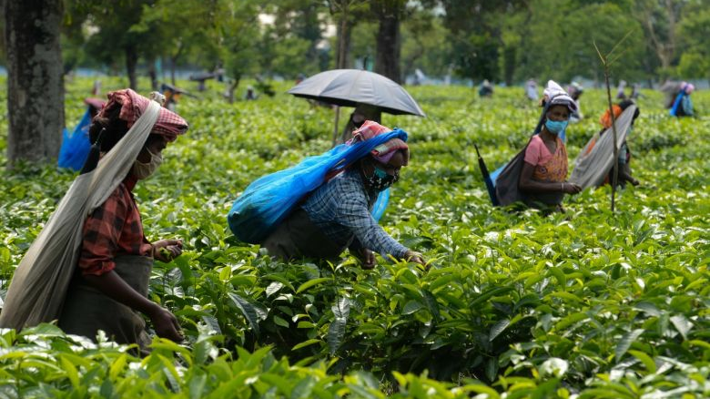
WELCOME TO HABIGANJ DISTRICT
FARJANA YESMIN OPI
22-47019-1

Slide 2
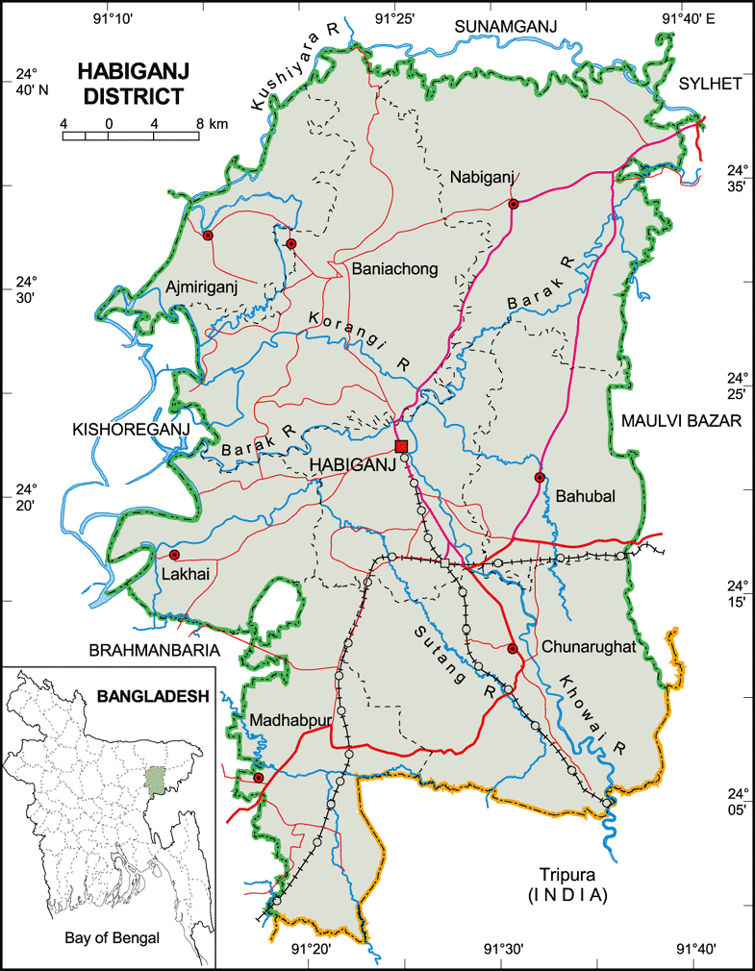
LOCATION
Habiganj is a district in the north-eastern part of Bangladesh
In Sylhet division.
Bounded by Sunamganj district on the north, Tripura State of India on the south, Moulvi Bazar and Sylhet districts on the east, Brahmanbaria and Kishoreganjdistricts on the west
Area of 2636 sq. k.m.

Slide 3
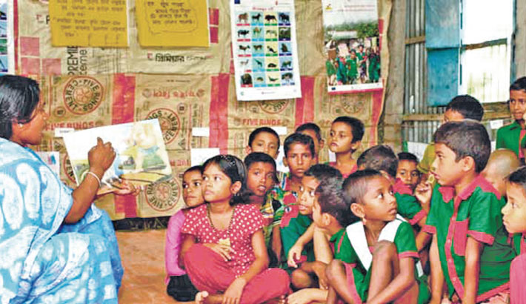
POPULATION AND LETERACY
According to the 2011 Bangladesh census, Habiganj District had a population of 2,089,001, of which 1,025,591 were males and 1,063,410 females.
Habiganj district has a literacy rate of 40.53% for the population 7 years and above: 42.22% for males and 38.94% for females.

Slide 4
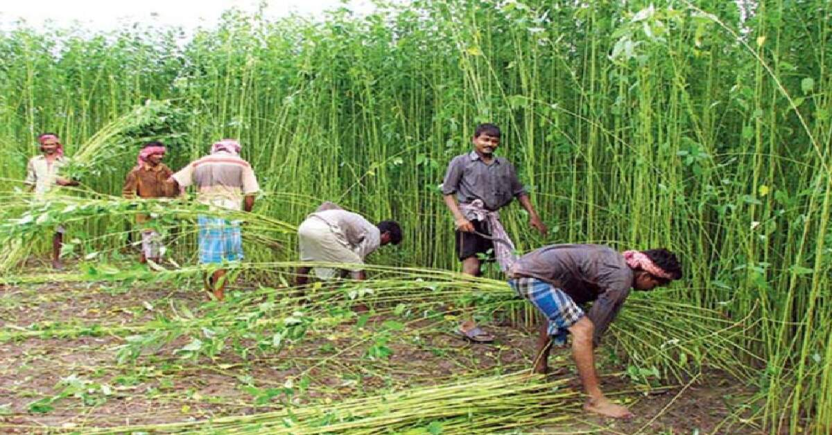
ECONOMY
Agriculture forms the backbone of Habiganj's economy, with a significant portion of the district's population engaged in farming. The fertile land and favorable climate support the cultivation of a wide range of crops, including rice, jute, tea, vegetables, fruits, and spices. Habiganj is particularly renowned for its high-quality tea production, contributing to the overall agricultural output and exports of the district.
In addition to agriculture, the district has a growing manufacturing sector, which includes small-scale industries and cottage enterprises. These industries primarily focus on food processing, textiles, ceramics, and handicrafts. The production of agricultural products like rice, jute, and tea serves as raw materials for many of these manufacturing units. The small industries not only contribute to the local economy but also generate employment opportunities for the local population.

Slide 5
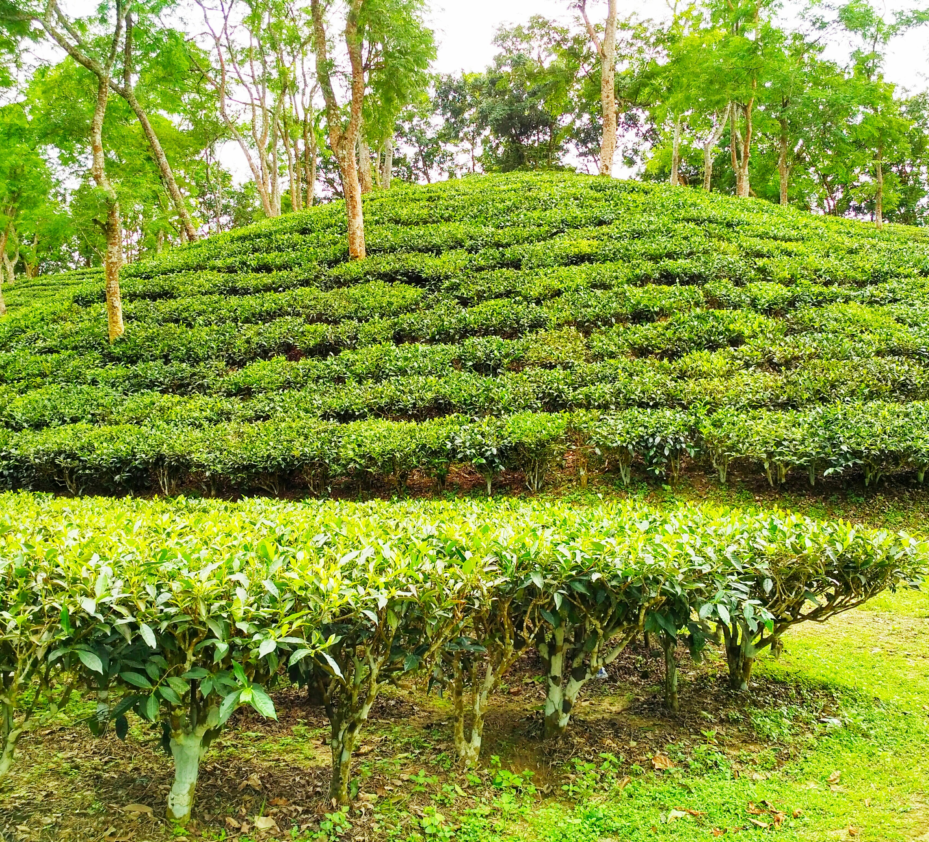
Tea Special Mention
Habiganj District is renowned for its exquisite tea production, contributing significantly to Bangladesh's tea industry.
The tea gardens of Habiganj are nestled in picturesque landscapes, cultivating some of the finest tea leaves in the country.
Habiganj's tea industry provides employment opportunities for thousands of workers, fostering economic growth and development in the region.
Visitors to Habiganj can indulge in the beauty of tea gardens, witness the tea-making process, and savor the rich flavors of Habiganj's signature tea.
The tea of Habiganj District represents the dedication and craftsmanship of the local tea growers, making it a symbol of pride for the district and Bangladesh as a whole.

Slide 6

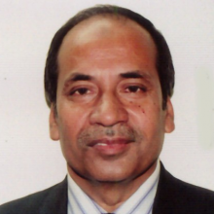

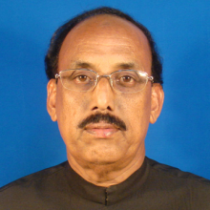
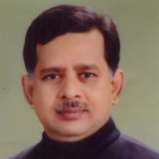
POLITICAL LEADERS
Mr. Mohammad Abdul Munim Chowdhury
Advocate Md. Abu Zahir
Habiganj-1
Habiganj-3
All are from Bangladesh Awami League
Md. Abdul Majid Khan
Md. Mahbub Ali
Habiganj-2
Habiganj-4

Slide 7
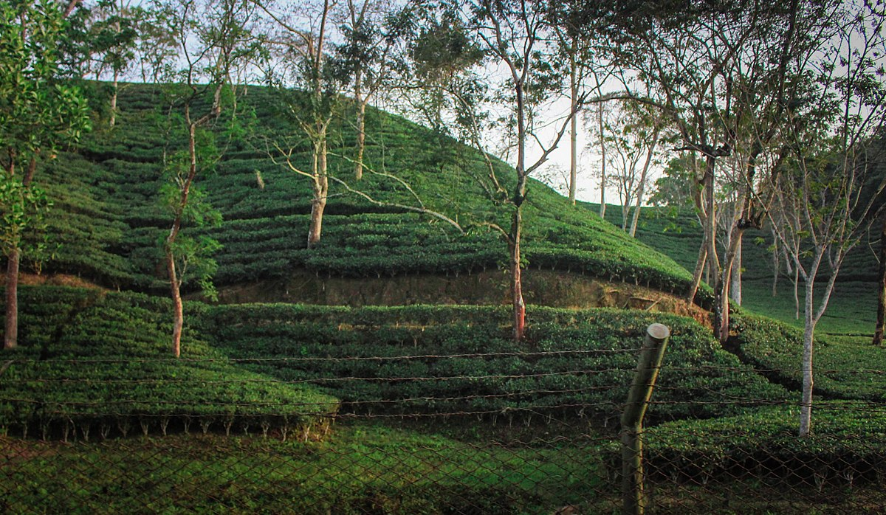
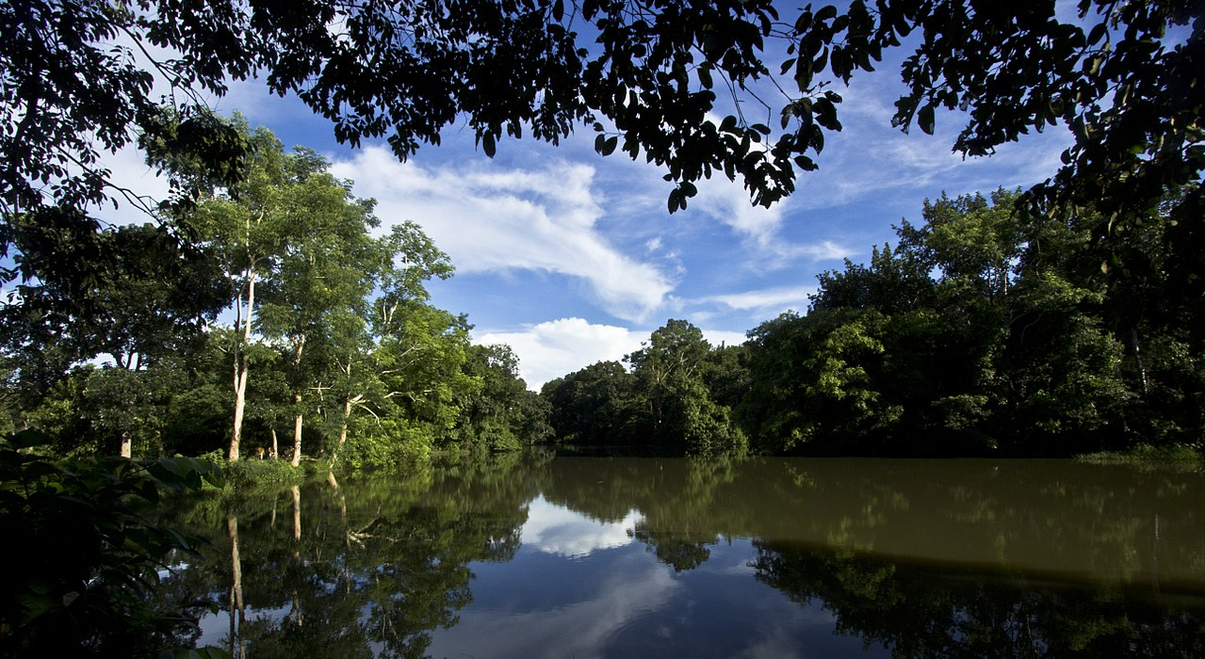
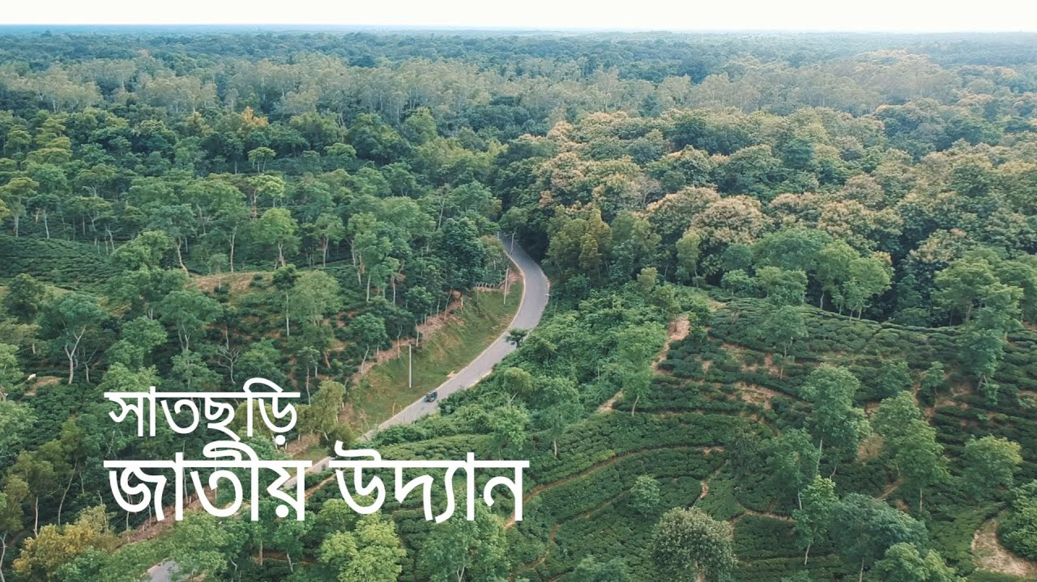
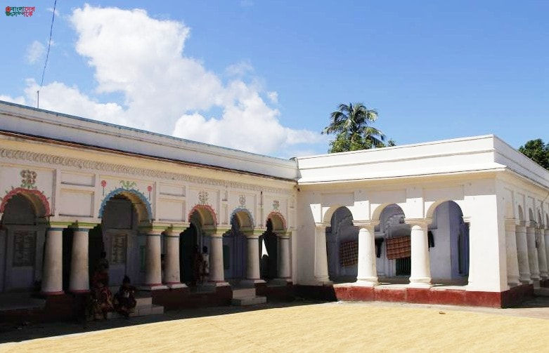
PLACES TO VISIT
Tea gardens
Rema-Kalenga Wildlife Sanctuary
Bithongol akhra
Satchari National Park

Slide 8
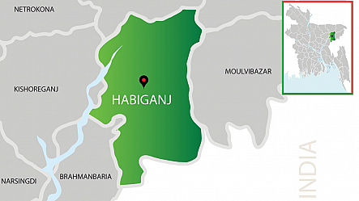
LET’S VISIT HABIGANJ
One of the main reasons to visit Habiganj is its stunning landscapes. The district is blessed with lush green tea gardens, picturesque hills, and mesmerizing waterfalls. Exploring the tea estates and witnessing the tea plucking process is an immersive experience that provides insights into the region's tea industry, which is an integral part of its economy.
A visit to Habiganj promises an unforgettable journey through nature's bounty and cultural heritage. From its scenic tea gardens to its captivating waterfalls and historical sites, Habiganj offers a unique blend of natural beauty and cultural exploration. So, if you are seeking an off-the-beaten-path destination in Bangladesh, Habiganj should definitely be on your travel itinerary.

Slide 9

THANK YOU
HAVE A NICE DAY

